Slide 1

Information Security BootCamp: Final Capstone Project - CYSA+
ELAINE REGINA CONSTANCIO

Slide 2




Summary
We provided you before with a very secure production and webserver and this time around we implemented a new way to log attacks on both servers with a handy tool called SNORT. “Snort is an IDS or intrusion Detection System that’s designed to detect and alert on irregular activities on a network, Snort is integrated by sensors delivering information to the server according to rules instructions. “ (https://linuxhint.com/snort_alerts/) After installing this package in your server and performing some exploits on additional vulnerabilities discovered we were quickly alerted of these attacks. With a tool like Snort, you can further secure your network to protect your data and much more! Thank you again for choosing us for all your cybersecurity needs!

Slide 3
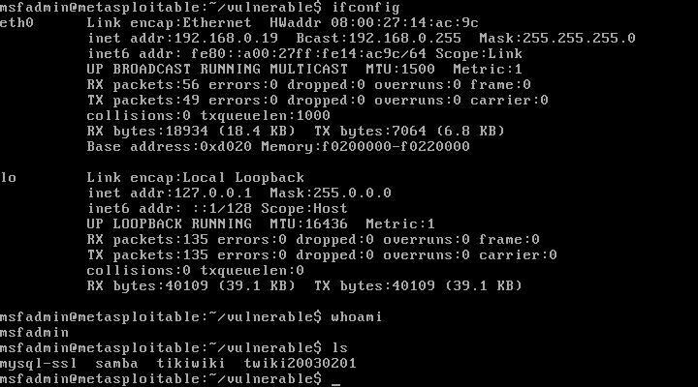
Configurations for Production Server

Slide 4

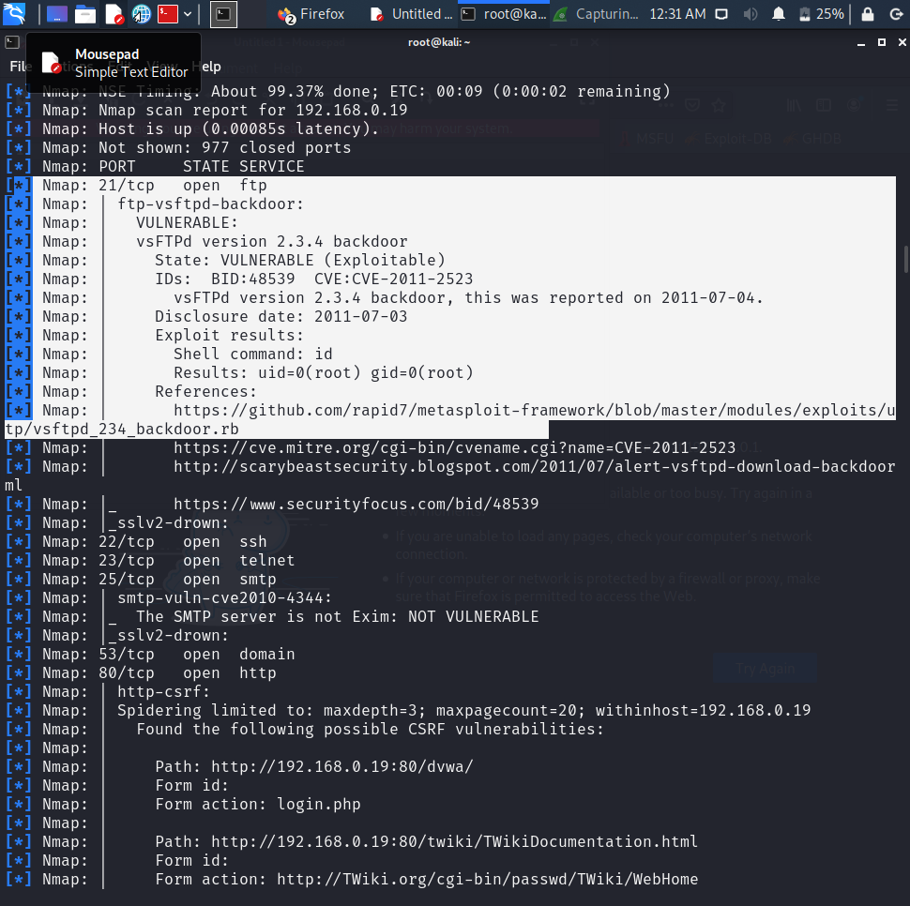
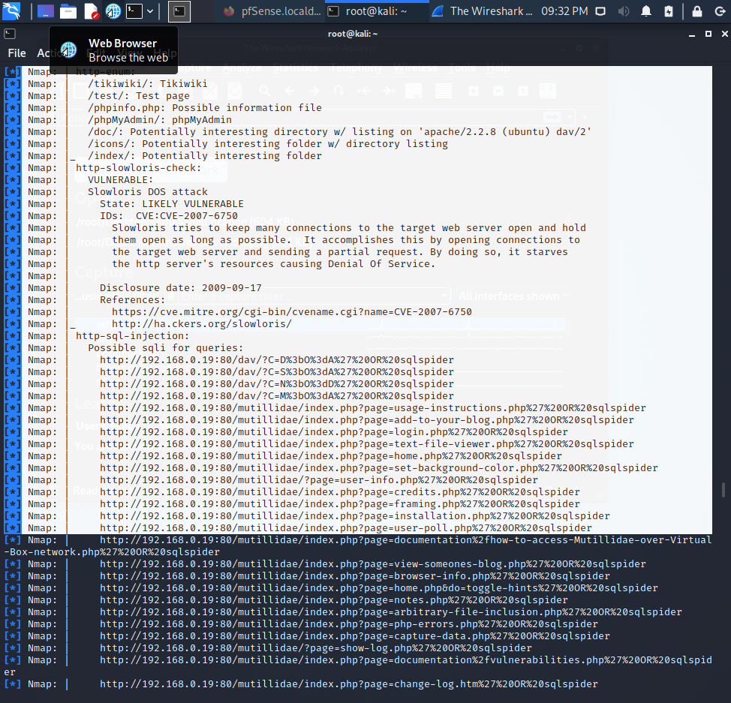

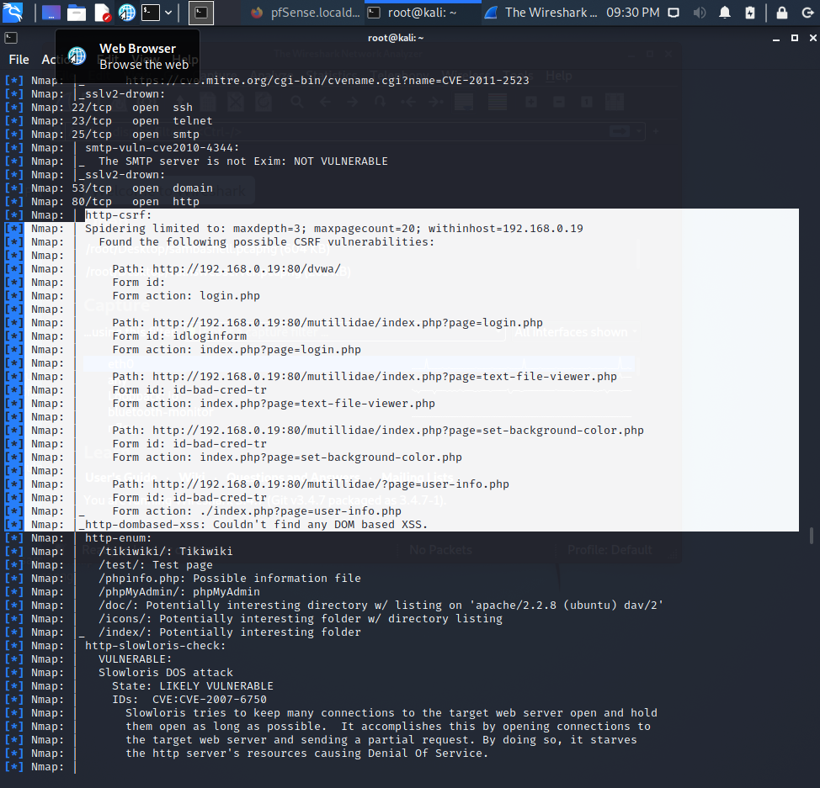

Nmap scans of Vulnerabilities on the Production Server
As you can see, we have discovered an ftp-vsftpd-backdoor vulnerability, and several others.

Slide 5
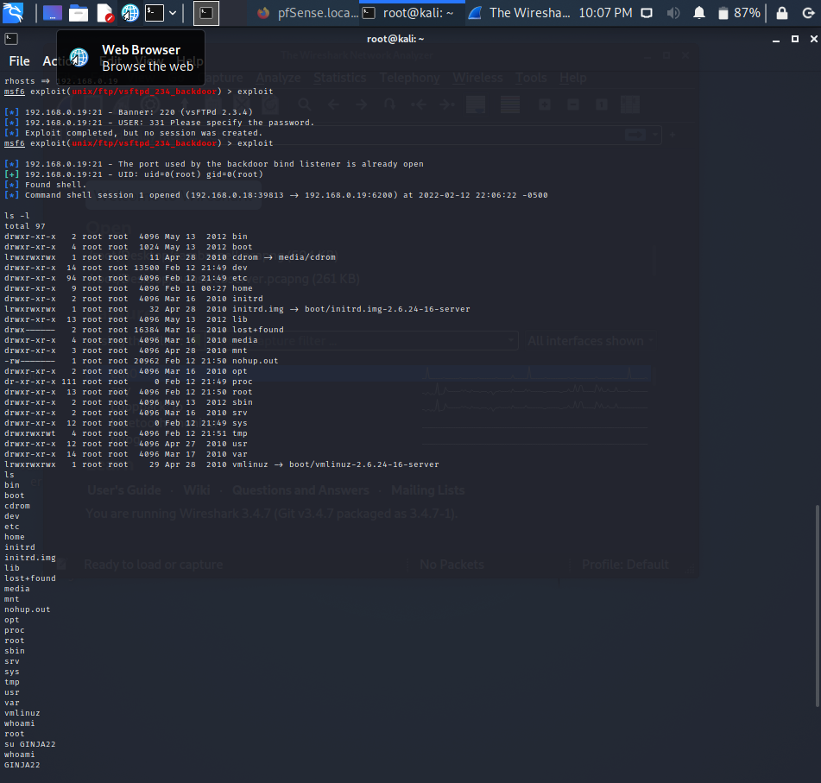

Exploits performed on Production Server

Slide 6
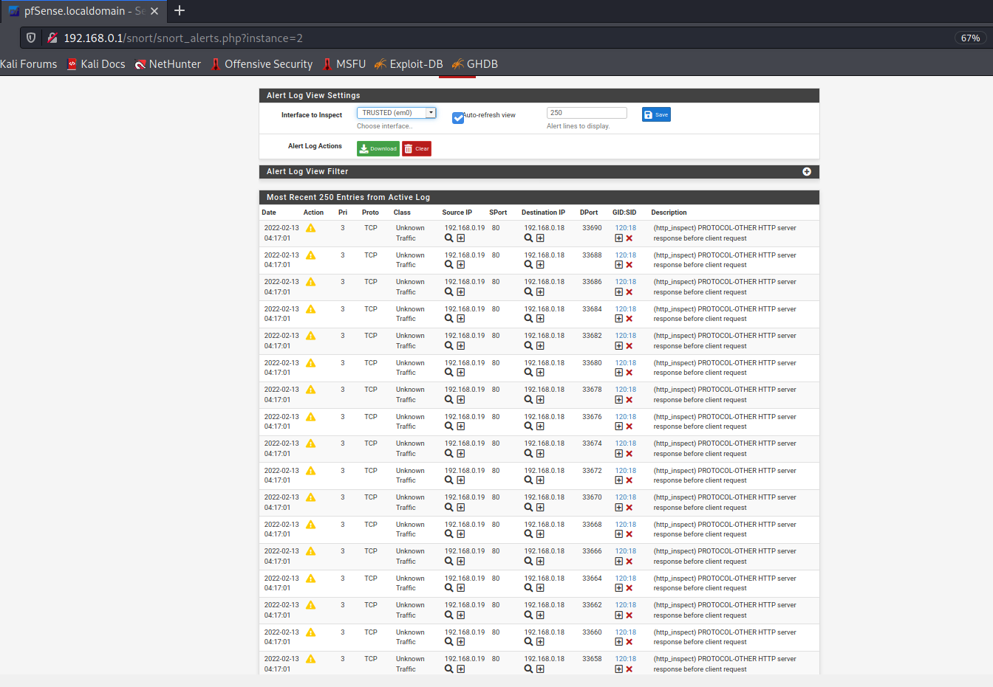
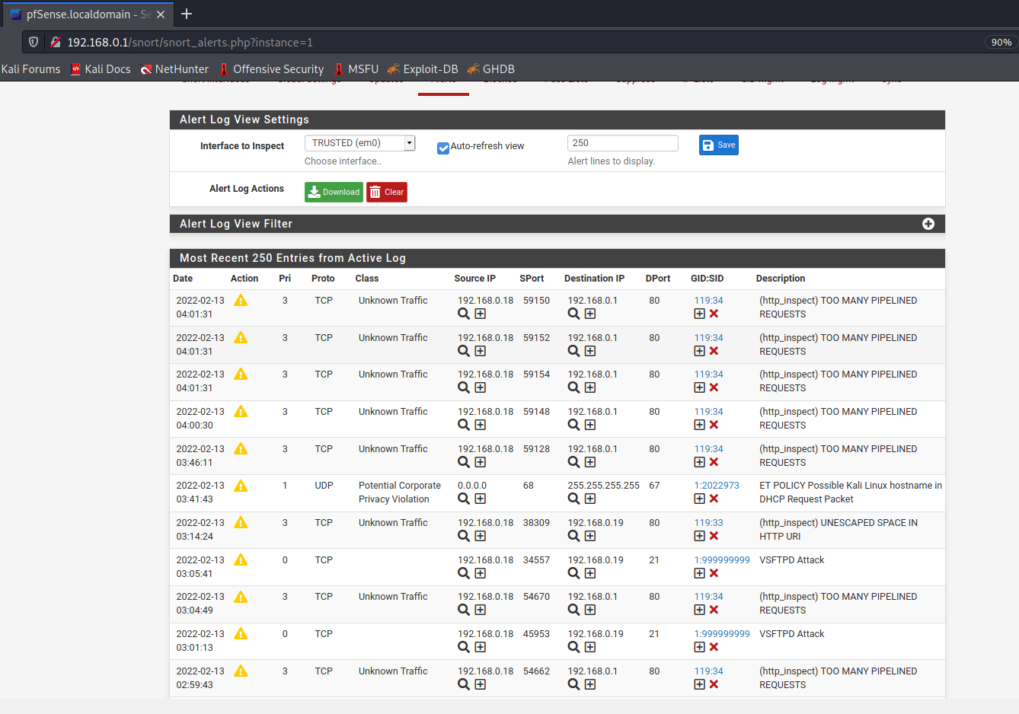
Snort Alerts of Attacks on Production Server
As you can see in the image, we have successfully set up Snort to pick up any irregular activity on your production server including a VSFTPD ATTACK and a slowloris DOS Attack

Slide 7
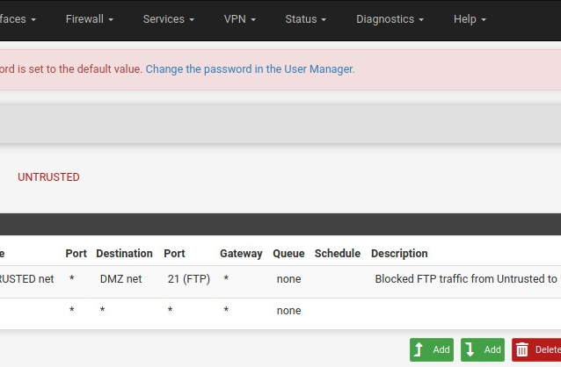
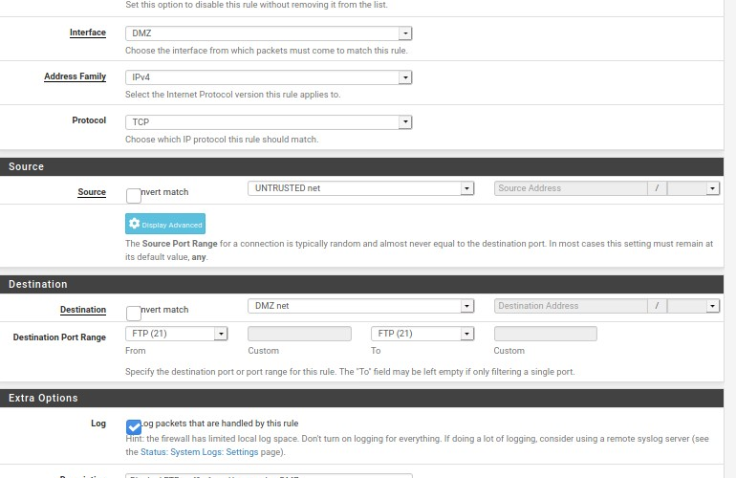
Firewall rule blocking FTP traffic tcp port from Untrusted Net to DMZ Network.

Slide 8

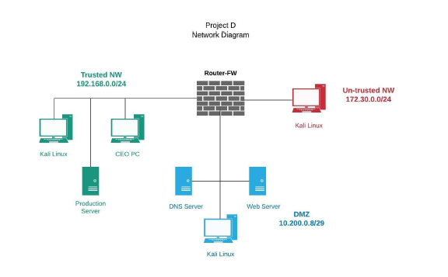
Network Diagram

Slide 9
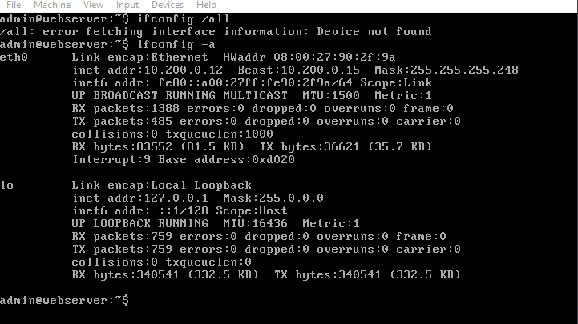
Configurations for Webserver

Slide 10
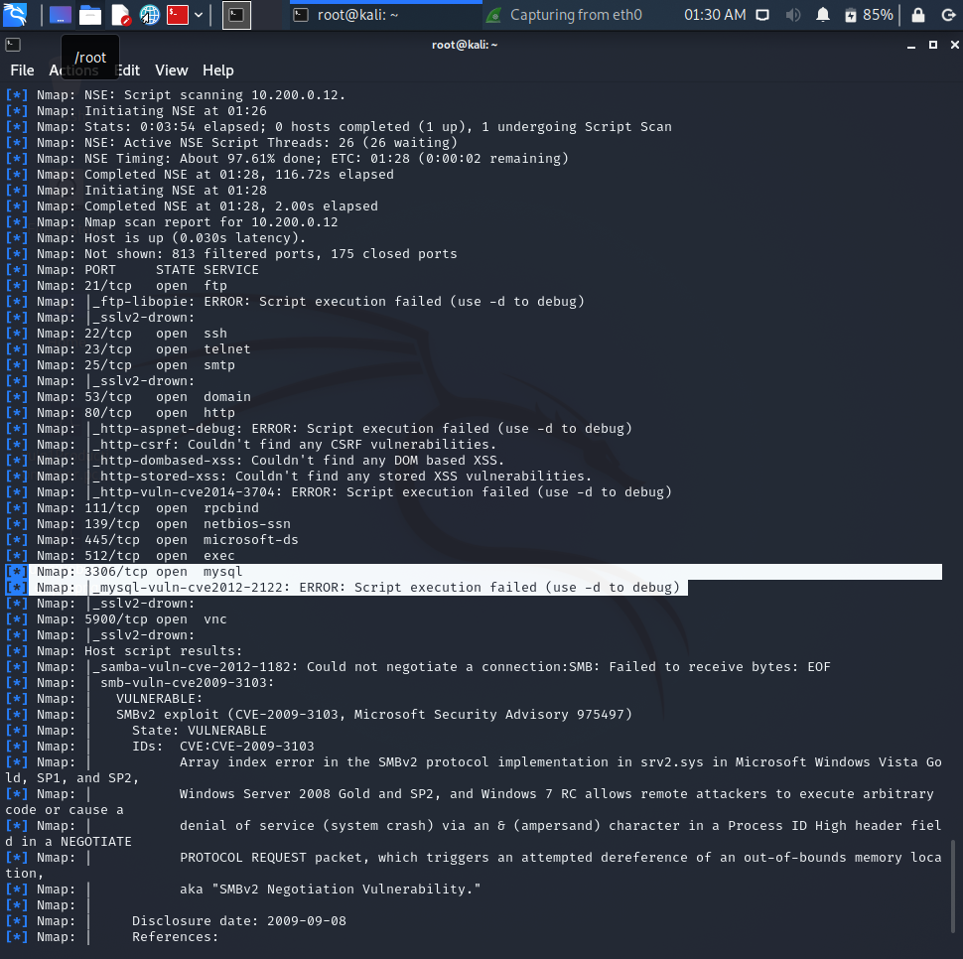
Nmap scans of Vulnerabilities on the Web Server
As you can see, we have discovered a mysql-ssl, samba vulnerabilities and many open ports, Please see slide for exploits performed.

Slide 11
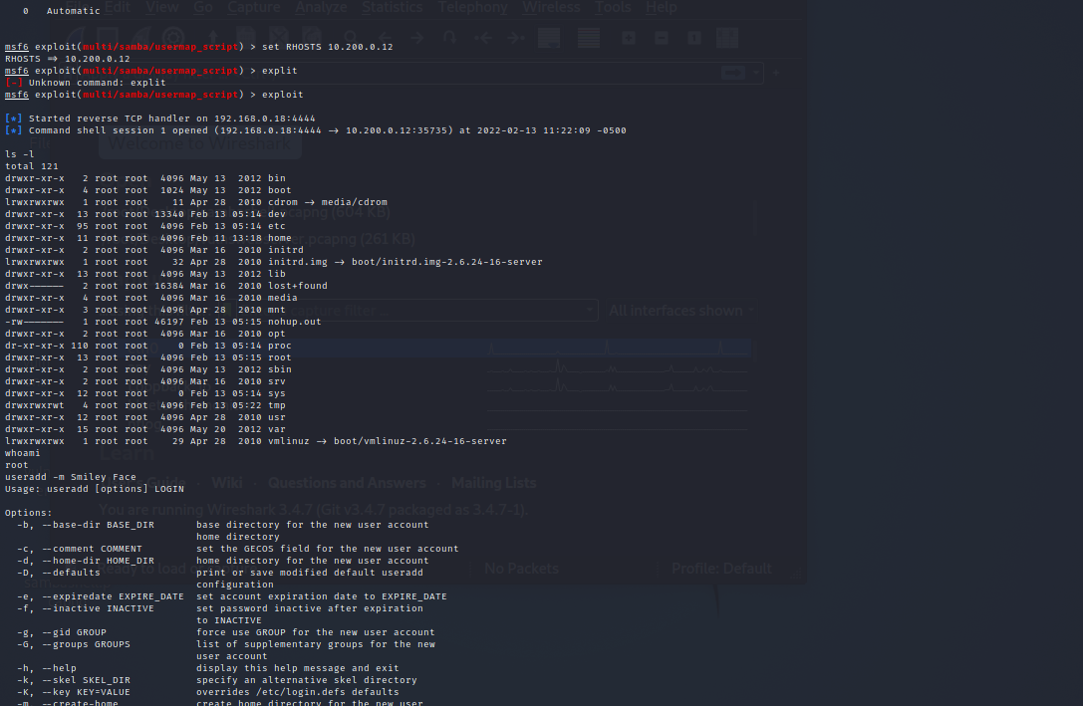
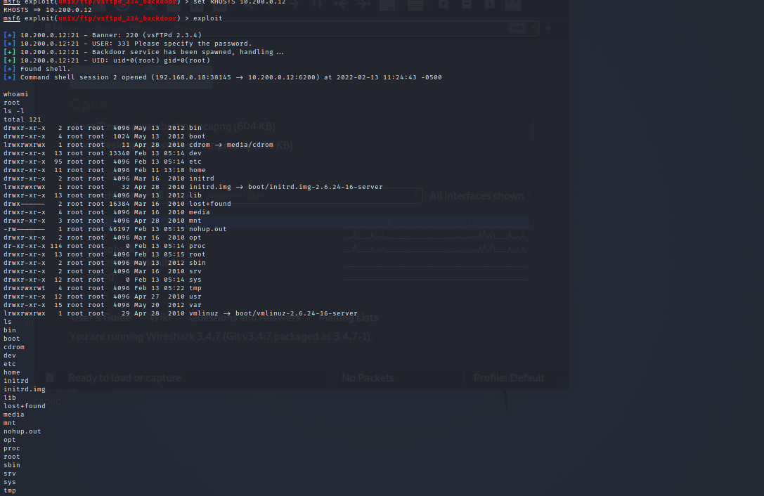
Exploits performed on Web Server
We were able to perform 2 different ftp exploits. Set up a shell session, add a user with escalated permissions and view all folders and files.

Slide 12
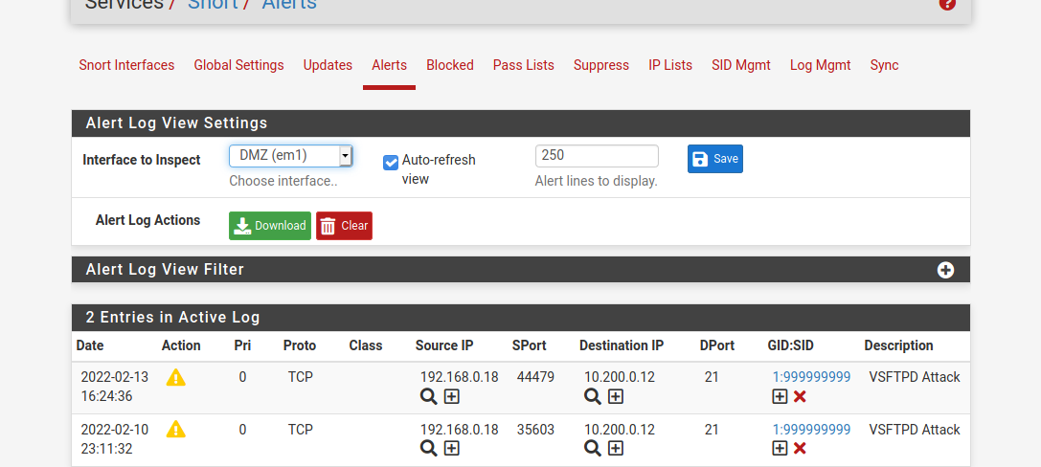
Snort Alerts of Attacks on Web Server
As you can see in the image, we have successfully set up Snort to pick up any irregular activity on your production server including a VSFTPD ATTACK.

Slide 13
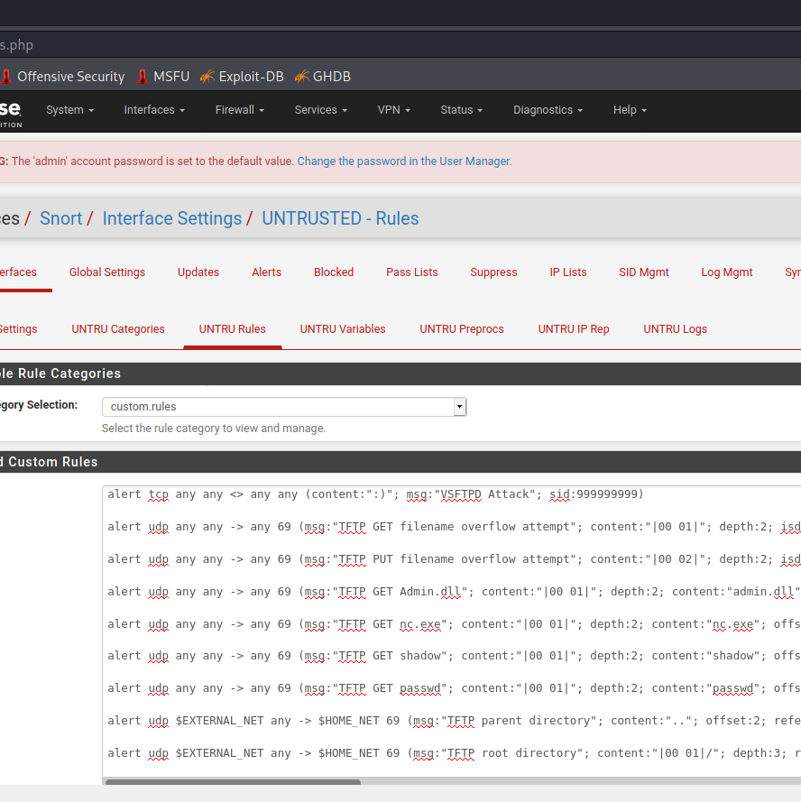
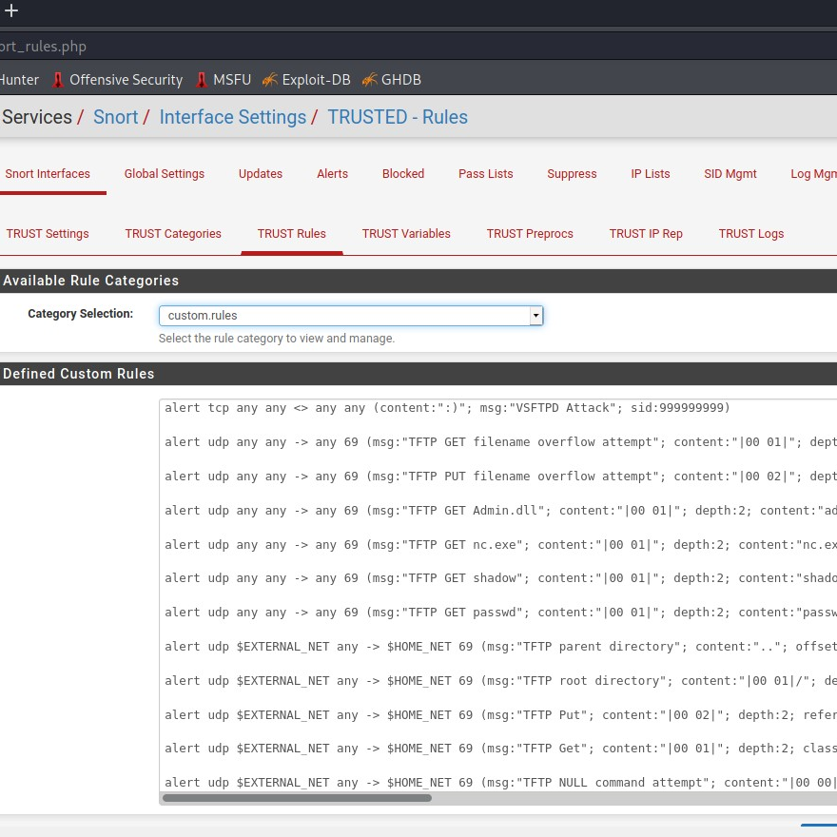
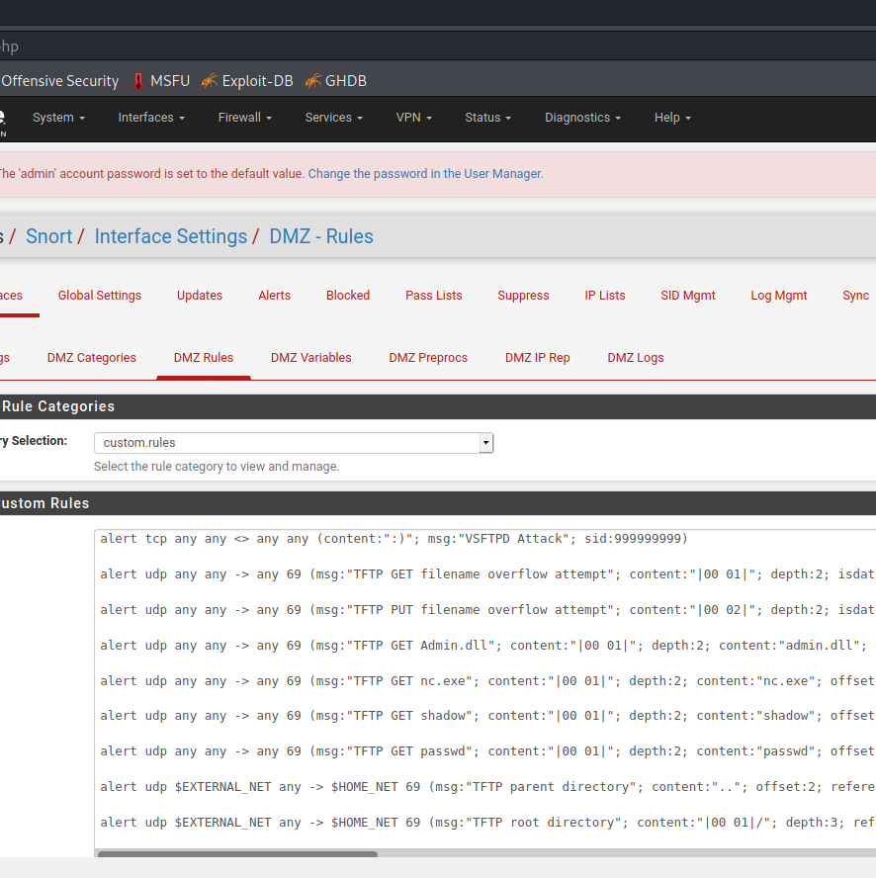
Snort Rules on Webserver & Production Server

Slide 14

Recommendation’s
In analyzing your network and discovering further vulnerabilities we installed the IDS/IPS system called SNORT. With snort we were able to include custom rule sets to alert you of any irregular activities in your entire network including and not limited to attacks of any sort. Our recommendation is that you continue to patch your system, and your pfSense firewall, checking for updates frequently, updating the rule sets, and continue to check the alerts on your open-source security tool SNORT. In closing, we want to congratulate you on take the next step in securing your network. GOOD JOB!

Slide 15



Thank You
Elaine Regina Constancio
innovatedtec@gmail.com
https://innovatedtec.wixsite.com/ginja22

